Slide 1
CSE 205 Digital Logic Design Week 3b Prime Implicants/Essential Prime Implicants
Dr. Mahmuda Naznin

Slide 2
Prime Implicants
Prime Implicants
Essential Prime Implicants
Non-essential primeIimplicants
Product-of-Sums optimization
Don’t cares

Slide 3
Implicants
Must cover all 1s of the function on K-map
Each 1 can be used multiple times in generating the terms of the expression
When you group 1’s on a K-map, generating a term, that term is an implicant of the function
Prime Implicants
Essential Prime Implicants

Slide 4
Prime Implicant
If removal of an any literal from an implicant P results in a product term that is not an implicant of the function, then P is a prime implicant.

Slide 5
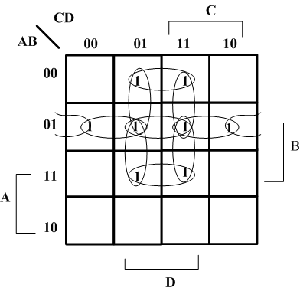
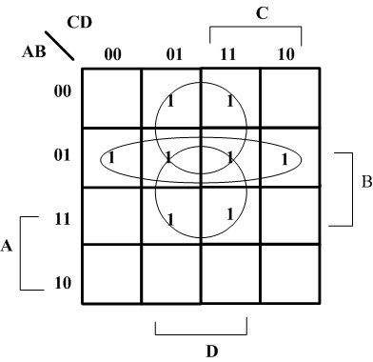
Implicants
Implicants with 2 1s with 4 1s

Slide 6
Some general statements on PI
A single 1 on a map is a prime implicant if is not adjacent to any other 1 of the function.
Two adjacent 1s on a map represent a prime implicant, provided that they are not within a rectangle of 4 or more squares containing 1s.
Four 1’s that are an implicant are a prime implicant if they are not within a group of 8.

Slide 7
Essential Prime Implicant
A prime implicant that contains a 1 that is not covered by any other prime implicant of the function is an essential prime implicant.
IT MUST BE INCLUDED IN ANY MINIMAL REPRESENTATION OF THE FUNCTION.

Slide 8
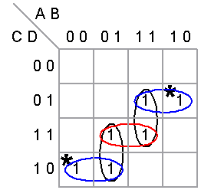
Karnaugh Map Examples
In the following examples the distinguished 1-cells are marked in the upper
left corner of the cell with an asterisk (*). The essential prime implicants are
circled in blue, the prime implicants are circled in black, and the non-essential
prime implicants included in the minimal sum are shown in red.
Example 1
Prime Implicants: 5
Distinguished 1-Cells: 2
Essential Prime Implicants: 2
Minimal Sums: 1
Y = A'CD' + AC'D + BCD

Slide 9
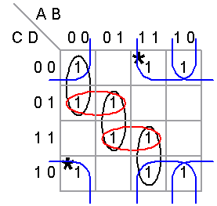
Example 2
Prime Implicants: 7
Distinguished 1-Cells: 2
Essential Prime Implicants: 2
Minimal Sums: 1
Y = B'D' + AD' + A'C'D + BCD

Slide 10
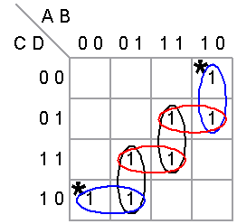
Example 3
Prime Implicants: 6
Distinguished 1-Cells: 2
Essential Prime Implicants: 2
Minimal Sums: 3
Y = AB'C' + A'CD' + AC'D + BCD
Y = AB'C' + A'CD' + ABD + A'BC
= AB'C' + A'CD' + ABD + BCD

Slide 11
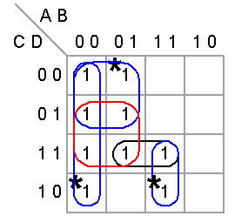
Example 4
Prime Implicants: 5
Distinguished 1-Cells: 3
Essential Prime Implicants: 3
Minimal Sums: 1
Y = A'B' + A'C' + ABC + A'D

Slide 12
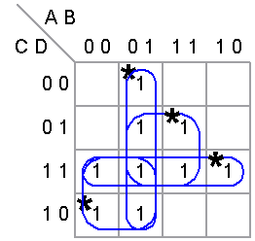
Example 5
Prime Implicants: 4
Distinguished 1-Cells: 4
Essential Prime Implicants: 4
Minimal Sums: 1
Y= A'C + A'B + BD + CD

Slide 13
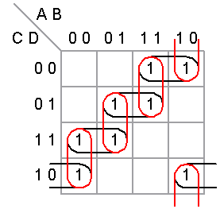
Prime Implicants: 8
Distinguished 1-Cells: 0
Essential Prime Implicants: 0
Minimal Sums: 2
Y = A'B'C + A'BD + ABC' + AB'D'
Y = B'CD' + A'CD + BC'D + AC'D'

